Slide 1
Innovation Through Security

Slide 2
To empower every person and every organization on the planet to achieve more
Microsoft’s Mission
To help customers to build and run a trusted digital fabric – hybrid and multi-cloud.
Microsoft Security

Slide 3
The Trusted Fabric
Compliance
Risk
Governance
Posture Management
Security Monitoring and Operations
Simplify
Know, Classify,
Protect Resources
Business Value
Great User
Experience
Integrate
Automate
Be Elastic

Slide 4
The Initiatives
Automated and Continuous Governance, Risk and Compliance
Modern Security Operations Center
Simplify
Resource Protection
and Governance
Zero Trust
SecDevOps
Integrate
Automate
Be Elastic

Slide 5
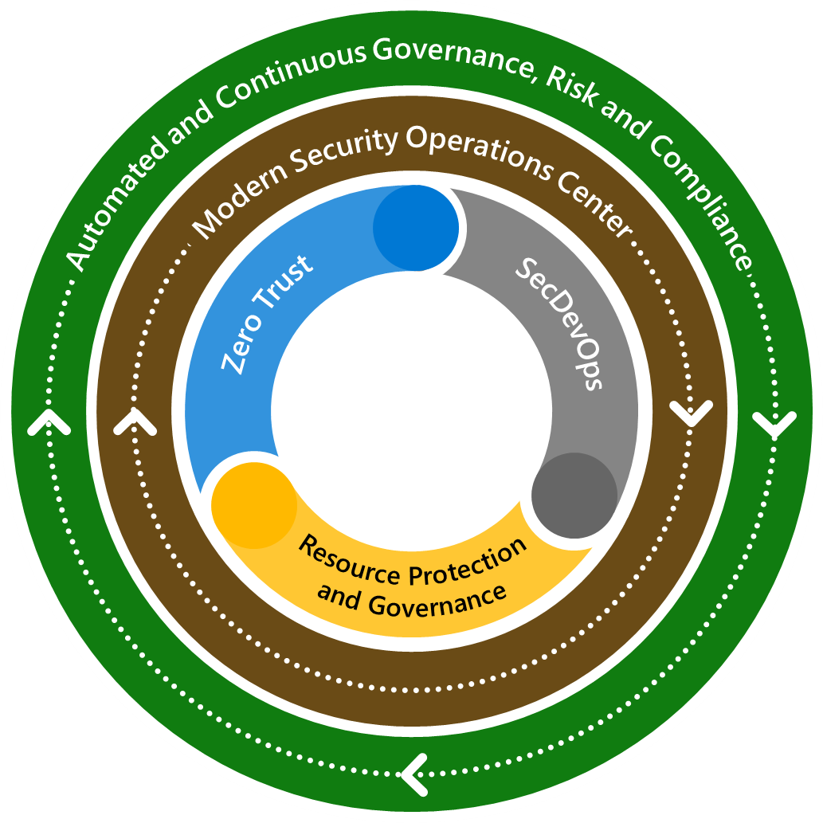
The Outside World
Criminal
Simplify
Hacktivist
Terrorist
Integrate
Automate
Be Elastic
Vandal
Nation State

Slide 6






Build an extensible platform
Covering multiple clouds and on-prem (hybrid)
Simplify
Trusted Digital Fabric
Integrate
Identity and access management
Information protection and governance
Compliance management
Threat protection
Automate
Cloud security
Risk management
Be Elastic

Slide 7
Microsoft Security Technology
Identity and access management
Secure access for a connected world
Threat protection
Stop threats across your entire organization
Cloud security
Comprehensive protection for multi-cloud resources, apps and data
Information protection and governance
Safeguard sensitive data across clouds, apps, and endpoints
Risk management
Identify and remediate critical data risks within your organization
Compliance management
Assess compliance and respond to regulatory requirements
Notes:
Talk track:
We are committed to a more integrated, end-to-end security approach. For Microsoft, this shows up in four broad technology areas:
Identity and Access Management: The vast majority of breaches begin with compromised passwords—they are the single weakest link in most security strategies. We start with strong identity and access management to protect your resources.
Threat Protection: Our customers consistently express their deep concerns about the high volume of data and alerts as well as the increasing sophistication and impact of attacks. By prioritizing integrated and automated threat protection, we help you meet the demand for advanced security that works in the real world.
Cloud Security: As enterprises move more of their workloads to the cloud, it has never been more important to protect your multi-cloud resources. From Azure to AWS, from Slack to Salesforce, we’ve built comprehensive cloud security to help protect every layer of your resources, regardless of which cloud or cloud apps you use.
Information Protection and Governance: Our customers also tell us about the difficulties they have to holistically and consistently protect and govern their information. Sixty-four percent of organizations report that employees externally share PII and other sensitive business data without encryption.¹ We’ve made information protection a priority to protect customers’ sensitive data wherever it lives or travels—so you can work with confidence.
Risk Management: Besides external threats, risks can also come from inside of the organizations. We’ve built solutions to help prevent, investigate, and remediate both malicious and inadvertent activities within your organizations.
Compliance Management: It is daunting and time-consuming to navigate the ever-evolving compliance landscape, and we are here to help simplify compliance and reduce risk by translating complex regulatory requirements into specific recommended actions.
1. Egress + OpinionMatters survey: https://www.businesswire.com/news/home/20190221005061/en/Survey-83-Percent-U.S.-Organizations-Accidentally-Exposed

Slide 8

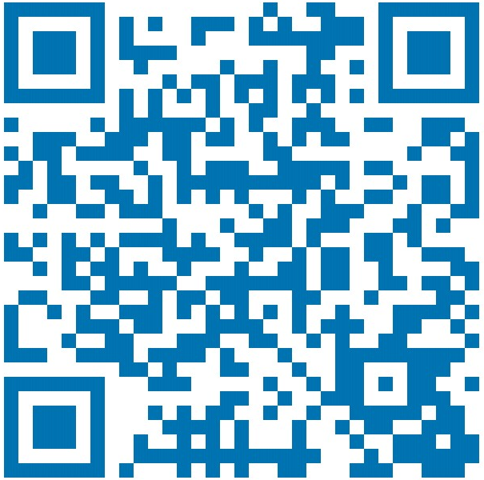
Thank you
Roger Halbheer
roger.halbheer@microsoft.com
+41 78 844 65 55

